Slide 1

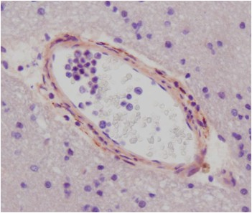
ReliaTech GmbH
Immunohistochemistry with anti-human VE-Statin/EGFL-7
(rabbit pab; RELIATech Cat# 102-PA14S / -PA14)
Staining of blood vessel endothelial cells in the white matter in human brain.
The experiment was performed by Dr. Mirko HH Schmidt, Institute of Neurology (Edinger Institute), Neuroscience Center, J.W. Goethe University Scholl of Medicine, Heinrich-Hoffmann-Str. 7, D-60528 Frankfurt, Germany
http://www.reliatech.de / orders@reliatech.de

